Slide 1

Credit card fraud detection
Team Members
Shivam Kumar 1SI18CS104
Satyam Mani Tripathi 1SI18CS102
Srijan Chandrakar 1SI18CS113
Sidhharth Tiwari 1SI18CS108
Suraj Jha 1SI18CS141
Amit Kumar 1SI18CS140
Swaroop K 1SI18CS121
Notes:
Line spacing + Page numbers

Slide 2
Agenda
01 Dataset and Library Info
02 Data PreProcessing
03 Basic Classification Algorithm
04 Handling Class Imbalance
05 F1-Score
06 Xgboost and RandomForest

Slide 3



Dataset and Library info(Basic)
01
VARIABLES
step - maps a unit of time in the real world. In this case 1 step is 1 hour of time. Total steps 744 (30 days simulation).
amount -amount of the transaction in local currency.
nameOrig – customer who started the transaction
oldbalanceOrg - initial balance before the transaction
newbalanceOrig - new balance after the transaction
nameDest - customer who is the recipient of the transaction
oldbalanceDest - initial balance recipient before the transaction. Note that there is not information for customers that start with M (Merchants).
newbalanceDest - new balance recipient after the transaction. Note that there is not information for customers that start with M (Merchants).
isFraud(Target) - This is the transactions made by the fraudulent agents inside the simulation. In this specific dataset the fraudulent behavior of the agents aims to profit by taking control or customers accounts and try to empty the funds by transferring to another account and then cashing out of the system.
isFlaggedFraud - The business model aims to control massive transfers from one account to another and flags illegal attempts. An illegal attempt in this dataset is an attempt to transfer more than 200.000 in a single transaction.
For Predictive Data Analysis
For Data Visualization
For data manipulation

Slide 4
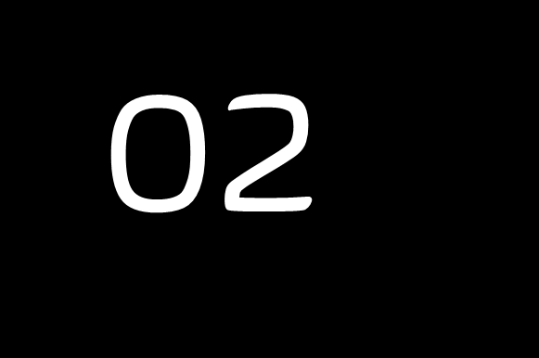
Data Preprocessing
Dropped Unnecessary Columns
Here we dropped names of origin and destination of Transaction that were done.
Converted to Numeric Data type
Here we converted “type” column to numeric form with the help of label encoder.
Checked for null entries in the dataset
We found out that there were no null entries
Checked for Distribution of different target variables
We found out that out of 6354407 total transactions only 8213 were fraud hence we came to conclusion that
Dataset is highly imbalanced.

Slide 5
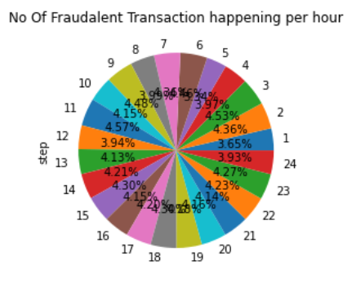
Data Preprocessing
Checked if “Step” could give us some information.
We were trying to check whether if there is any particular hour where no of Fraudalent
transaction were more but there was not much insight the result showed that they were
happening evenly throughout the period.
Created class for independent and target variable for final model training
Target variable : isFraud
Independent variable: step, type, amount, oldBalanceOrg, newbalanceOrg,
oldbalanceDest and newbalanceDest

Slide 6
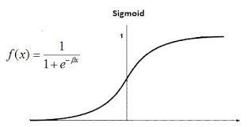
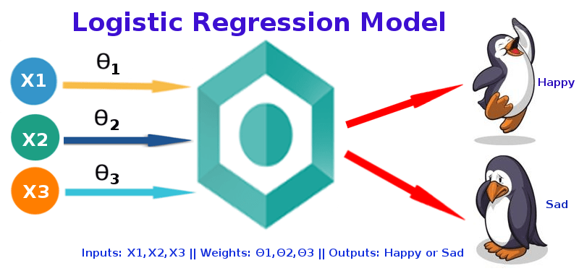
Basic Classification Algorithms
03
Logistic Regression
Logistic Regression is is a classification algorithm used to find the probability of event success and event failure.
Logistic Regression predicts whether something is True or False, instead of predictiing something continuous.
It is used when the dependent variable is binary(0/1, True/False, Yes/No) in nature.
It supports categorizing data into discrete classes by studying the relationship from a given set of labelled data.

Slide 7
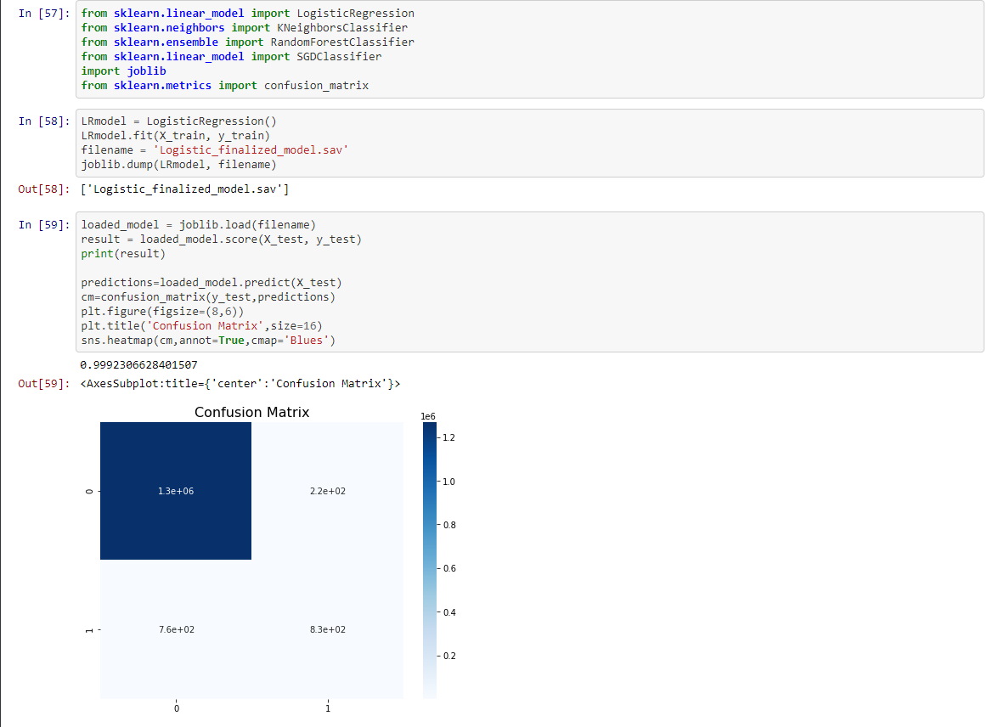
Implementation

Slide 8
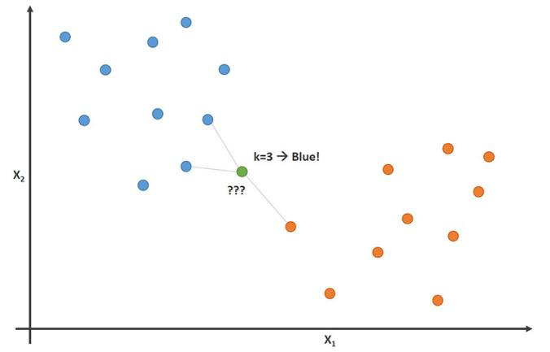
KNN(K Nearest Neighbour)
K-nearest neighbors (KNN) algorithm is a type of supervised ML algorithm which can be used for both classification as well as regression predictive problems. However, it is mainly used for classification predictive problems in industry
K-nearest neighbors (KNN) algorithm uses ‘feature similarity’ to predict the values of new datapoints which further means that the new data point will be assigned a value based on how closely it matches the points in the training set.

Slide 9
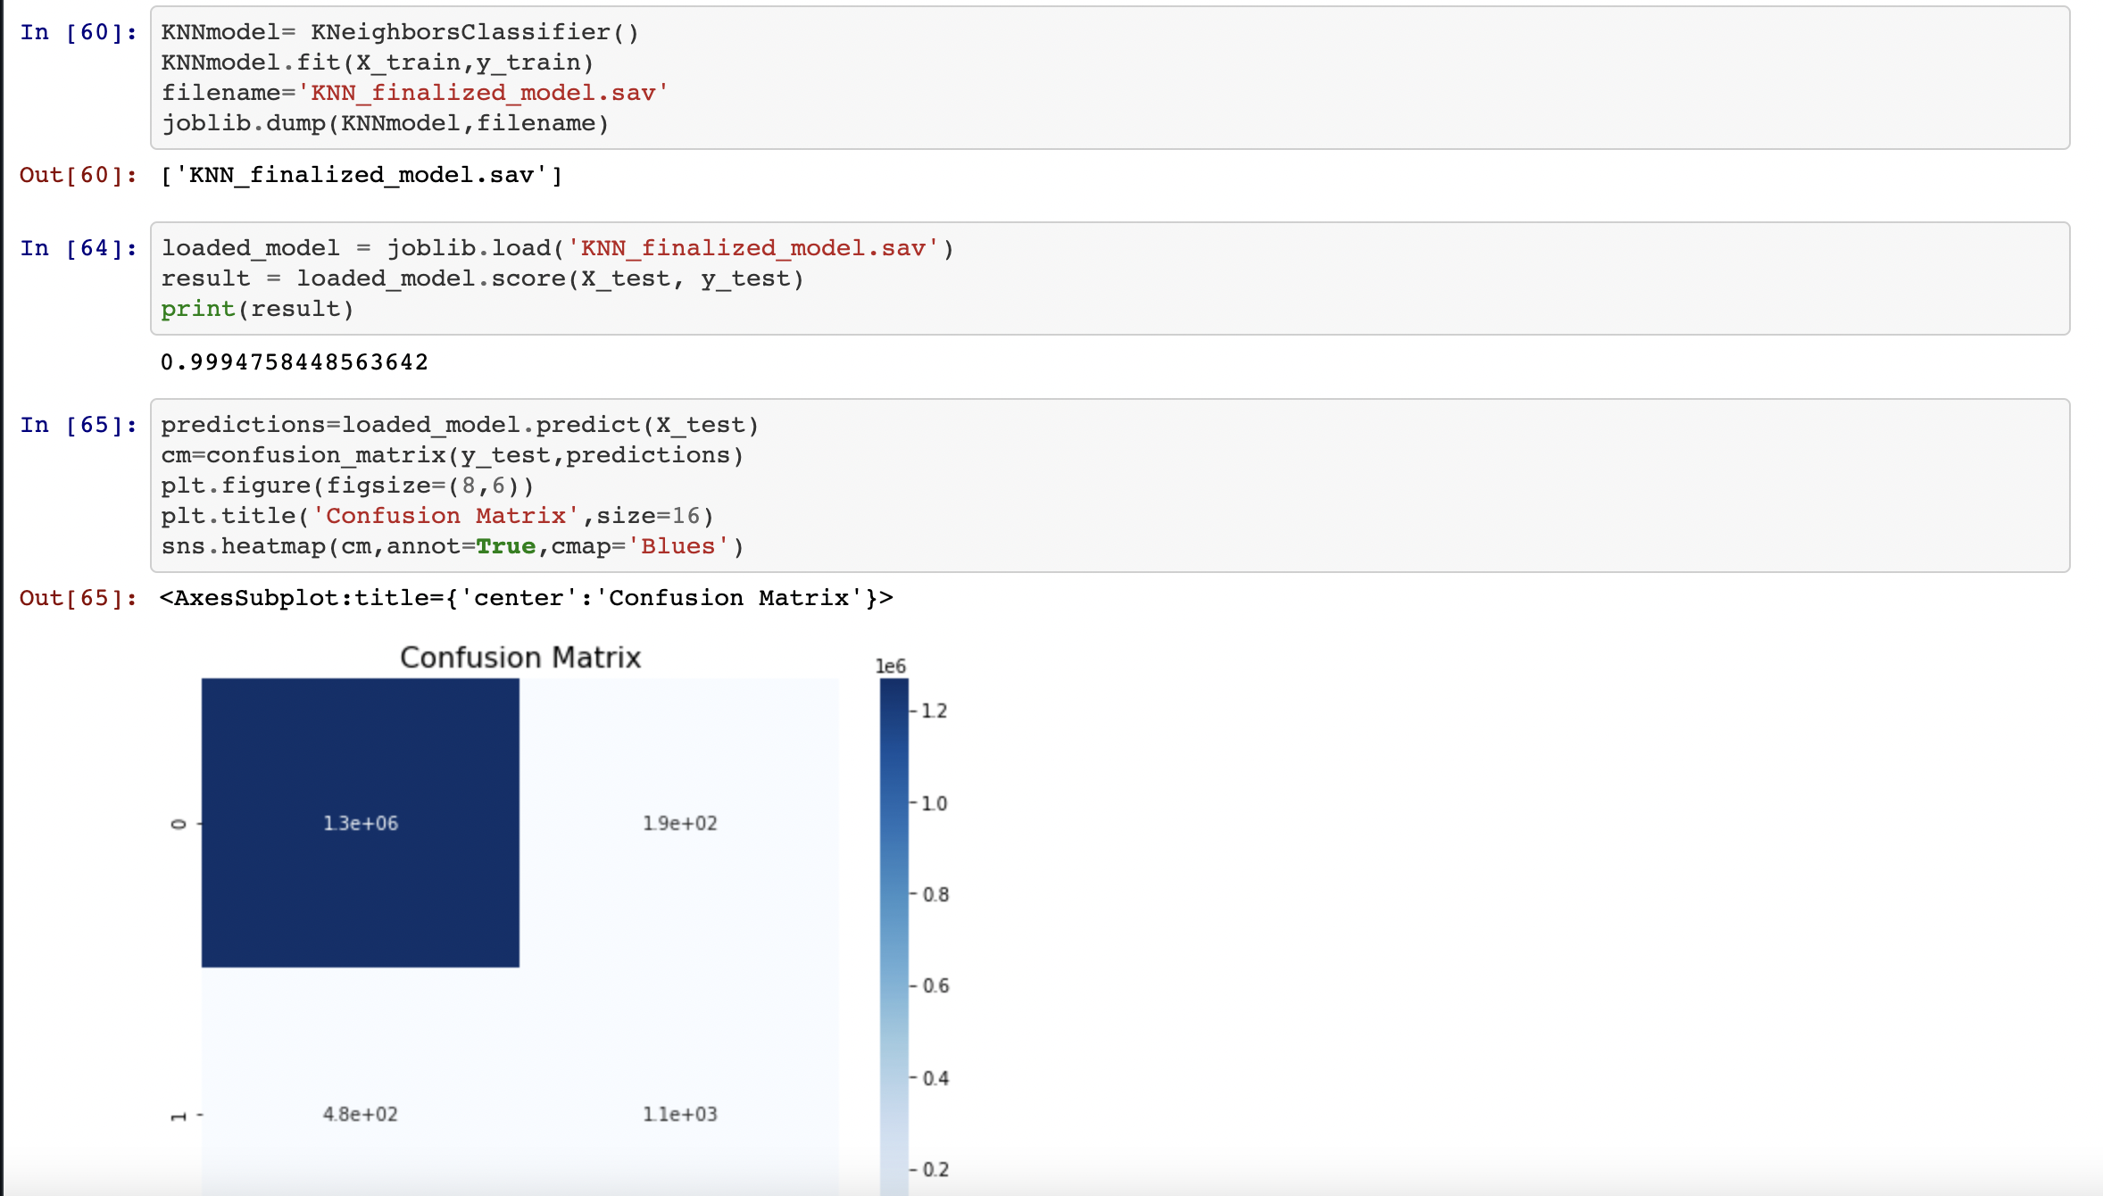
Implementation

Slide 10
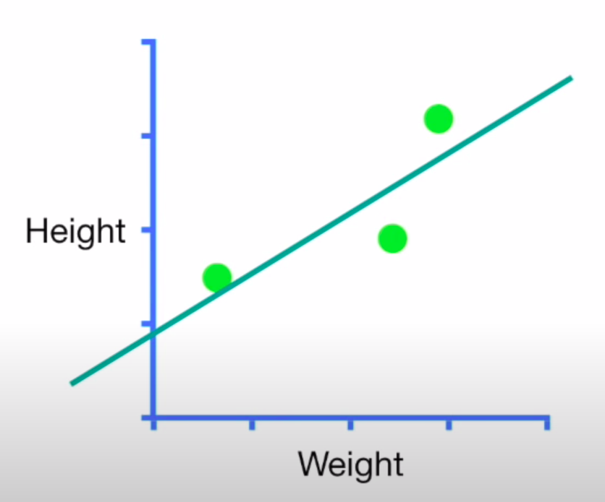
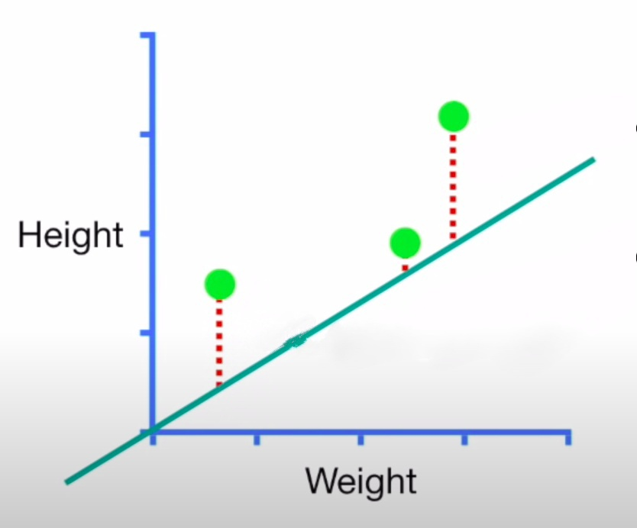
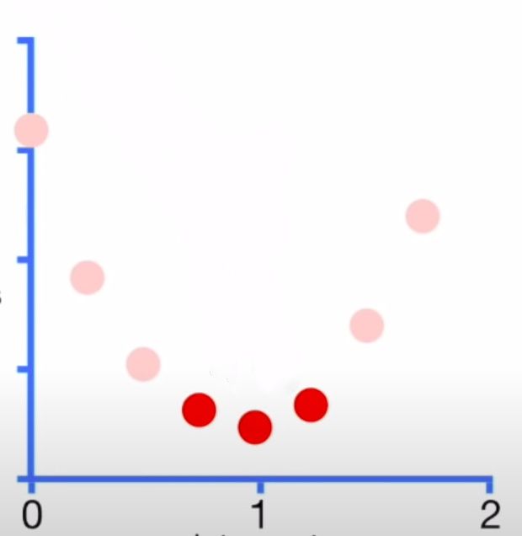
Gradient Descent
Gradient Descent is an optimization algorithm for finding a local minimum of a differentiable function.
By far the most common way to optimize models and neural networks.
Consider a simple example of linear regression to understand Gradient Descent
Our goal is to fit the line to data.
To fit the line, we need to find optimal value of slope & intercept.
For simplicity, we estimated the slope to be 0.6.
For simplicity, we estimated the slope to be 0.6.
Predicted Height = intercept + 0.6 * weight
Finding gradient Descent
Pick a random value of intercept, say 0.
Our Plot for Loss Function
We will evaluate how well this line fits the data using loss function.
Loss Function = Sum of square of Residuals
= (h1 - ph1)² + (h2 - ph2)² + (h3 - ph3)²

Slide 11
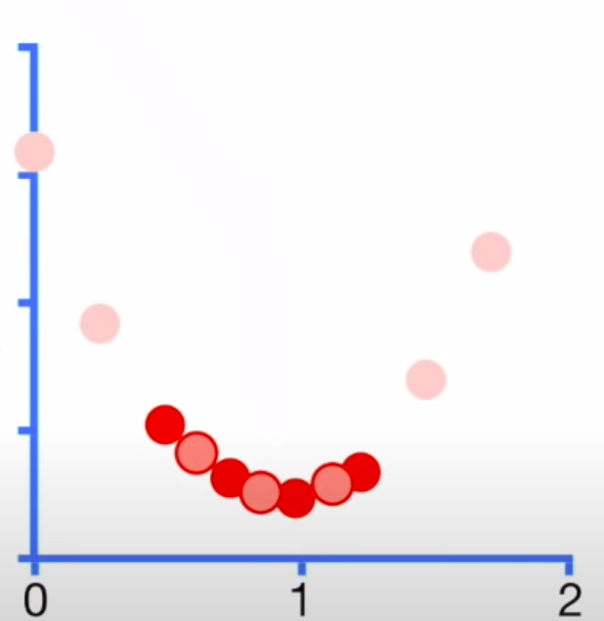
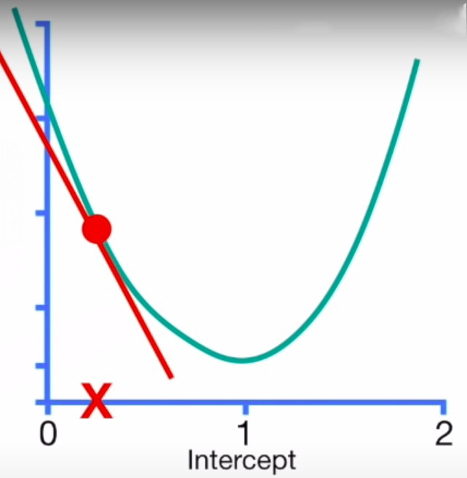
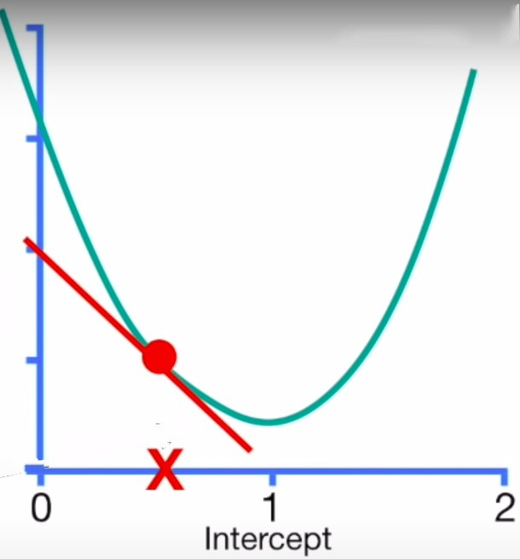
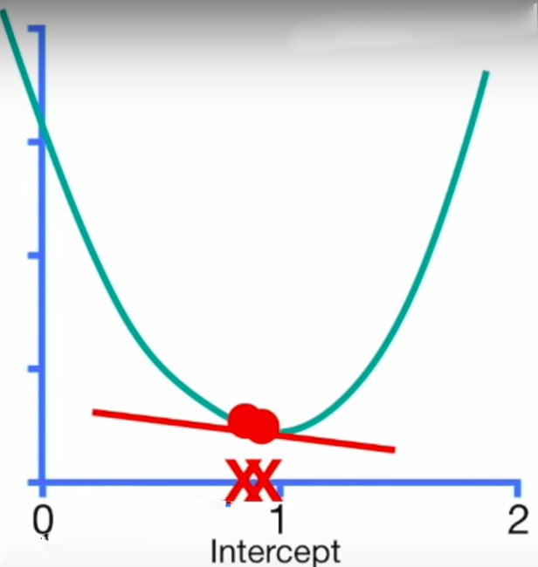
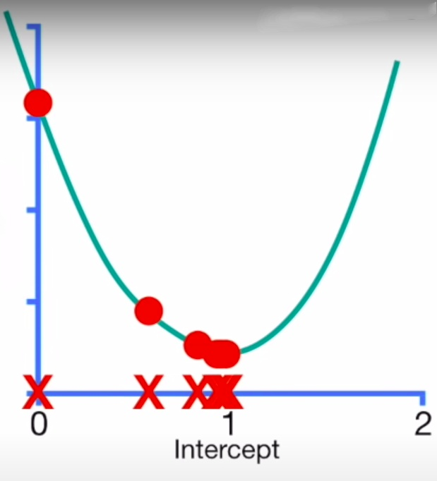
Finding gradient Descent
A better Solution is to take big steps when it is far from optimal value and take smaller steps closer to optimal value.
Gradient Descent
Step Size = Slope * learning rate

Slide 12
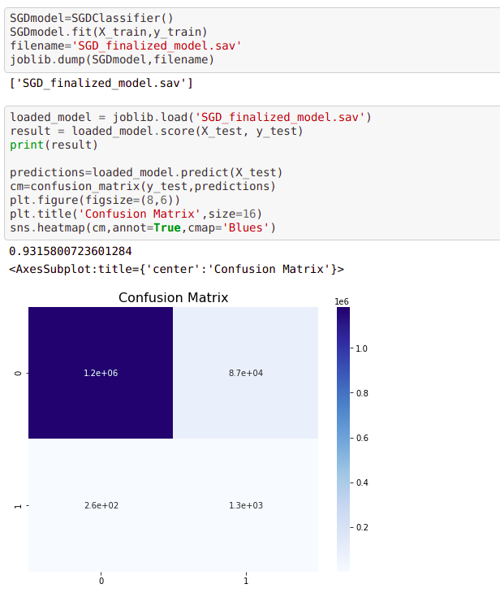
Stochastic Gradient Descent
SGD to our model
Is a variation of gradient descent
Say we have 100000 data points and 10 features.Then we would have to calculate 100000 terms for each of 100 derivatives.
Thus, gradient descent is slow on huge data.
“Stochastic”, in plain terms means “random”.
SGD randomly picks one data point from the whole data set at each iteration to reduce the computations enormously.

Slide 13
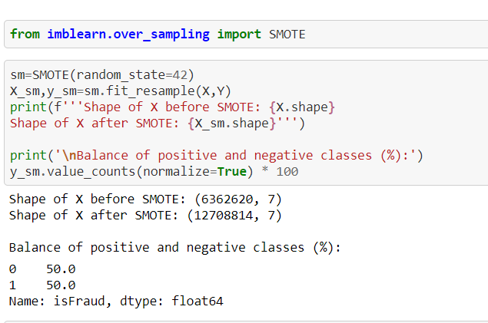
Handling Class Imbalance
04
Sampling
Under Sampling : Deleting samples from the majority class.
We should not prefer this as this may cause us to losse most of the data and we should never
let the good data go to waste.
Over Sampling : Generating more samples from minority class.
There are generally two ways to do that
Create a generative model and then create new samples.
SMOTE and ADASYN(Standard).
We should not do this as this is Computationally expensive and algorithmically more involved.
The size increased almost by 100%(almost doubled)

Slide 14
Using hyperparameters to set weights
It will give more weight to under represented class
1.For XGBoost
We just assign weights , the algorithm takes care of the imbalance.
So, in our running example of 10,000 B (positive) and 1,000 A (negative) samples, if we want to train our XGBoost classifier on this dataset we would set the value of scale_pos_weight to be 10,000/1,000 = 10.
2.For Random Forest
Set the class_weight hyperparameter. Pass a dictionary which has weights as values and classes as keys. Eg. Let class 0 have 10 times more data points than class 1. class_weight = {0:1,1:10} . We assign a weight of 1 to class 0 (majority) and 10 to class 1 (minority)

Slide 15
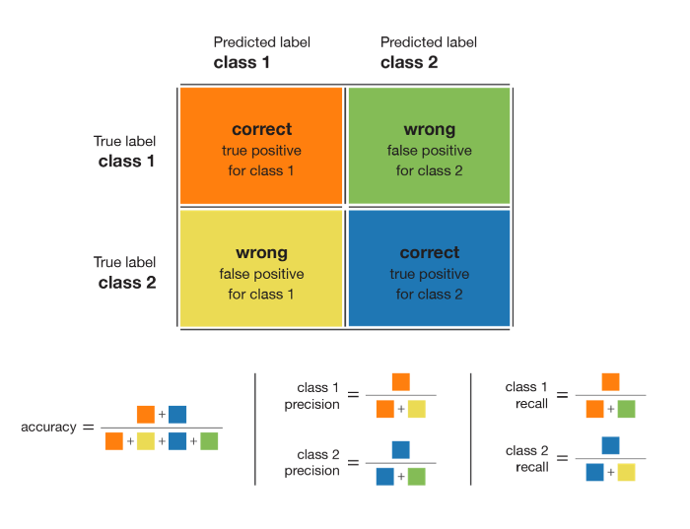
Why not accuracy!
Precision is defined as the fraction of relevant instances among all retrieved instances.
Recall, sometimes referred to as ‘sensitivity, is the fraction of retrieved instances among all relevant instances.
high recall + high precision : the class is perfectly handled by the model
low recall + high precision : the model can’t detect the class well but is highly trustable when it does
high recall + low precision : the class is well detected but the model also include points of other classes in it
low recall + low precision : the class is poorly handled by the model

Slide 16
F1 Score( The higher, the better )
F1 score of a class is given by the harmonic mean of precision and recall (2×precision×recall / (precision + recall)) high recall + high precision : the class is perfectly handled by the model. The model detects the class well and is also highly trustable when it does.

Slide 17
XGBoost
06
The library is laser focused on computational speed and model performance, as such there are few frills.
Three main forms of gradient boosting are supported: Gradient Boosting, SG Boosting and Regular Gradient Boosting.
We can assign values to the hyperparameters, which helps us deal with imbalance class. Hyperparameters can be number of trees, depth of tree, etc.
A design goal was to make the best use of available resources to train the model. Some key algorithm implementation features include: Sparse Aware, Block Structure and Continued Training.

Slide 18
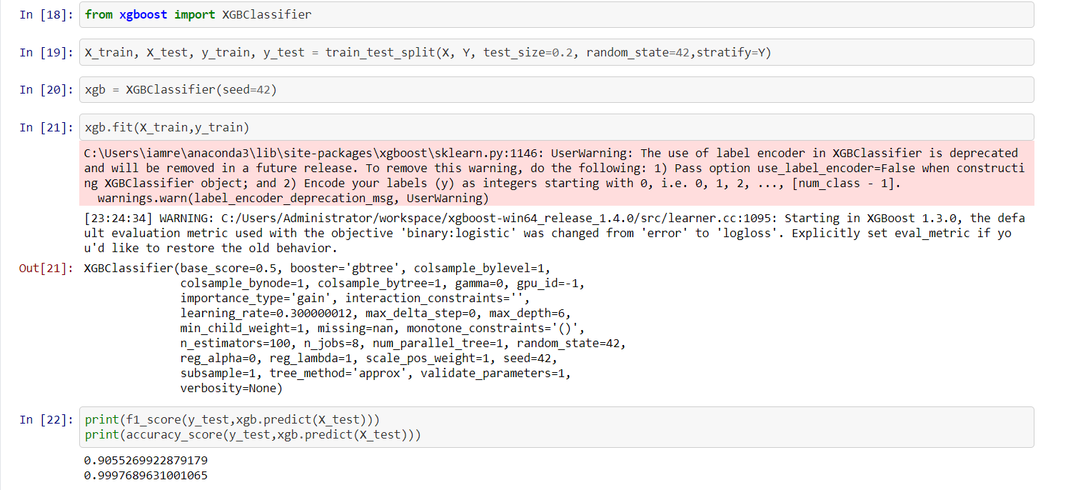
Fig : XGBoost applied on the given dataset.

Slide 19
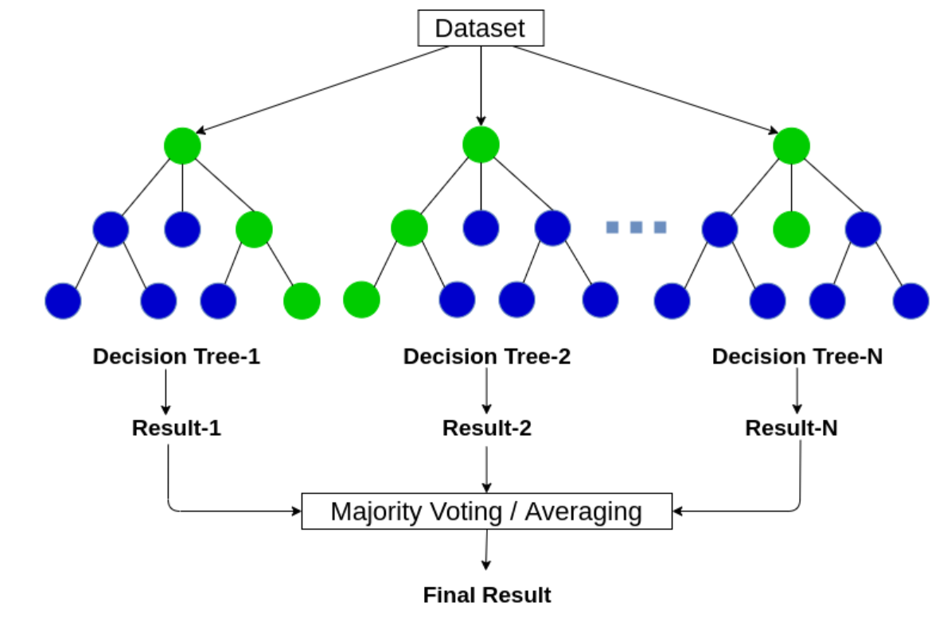
RANDOM FOREST
Random Forest is a tree-based machine learning algorithm that leverages the power of multiple decision trees for making decisions. As the name suggests, it is a “forest” of trees!
But why do we call it a “random” forest? That’s because it is a forest of randomly created decision trees. Each node in the decision tree works on a random subset of features to calculate the output. The random forest then combines the output of individual decision trees to generate the final output.

Slide 20
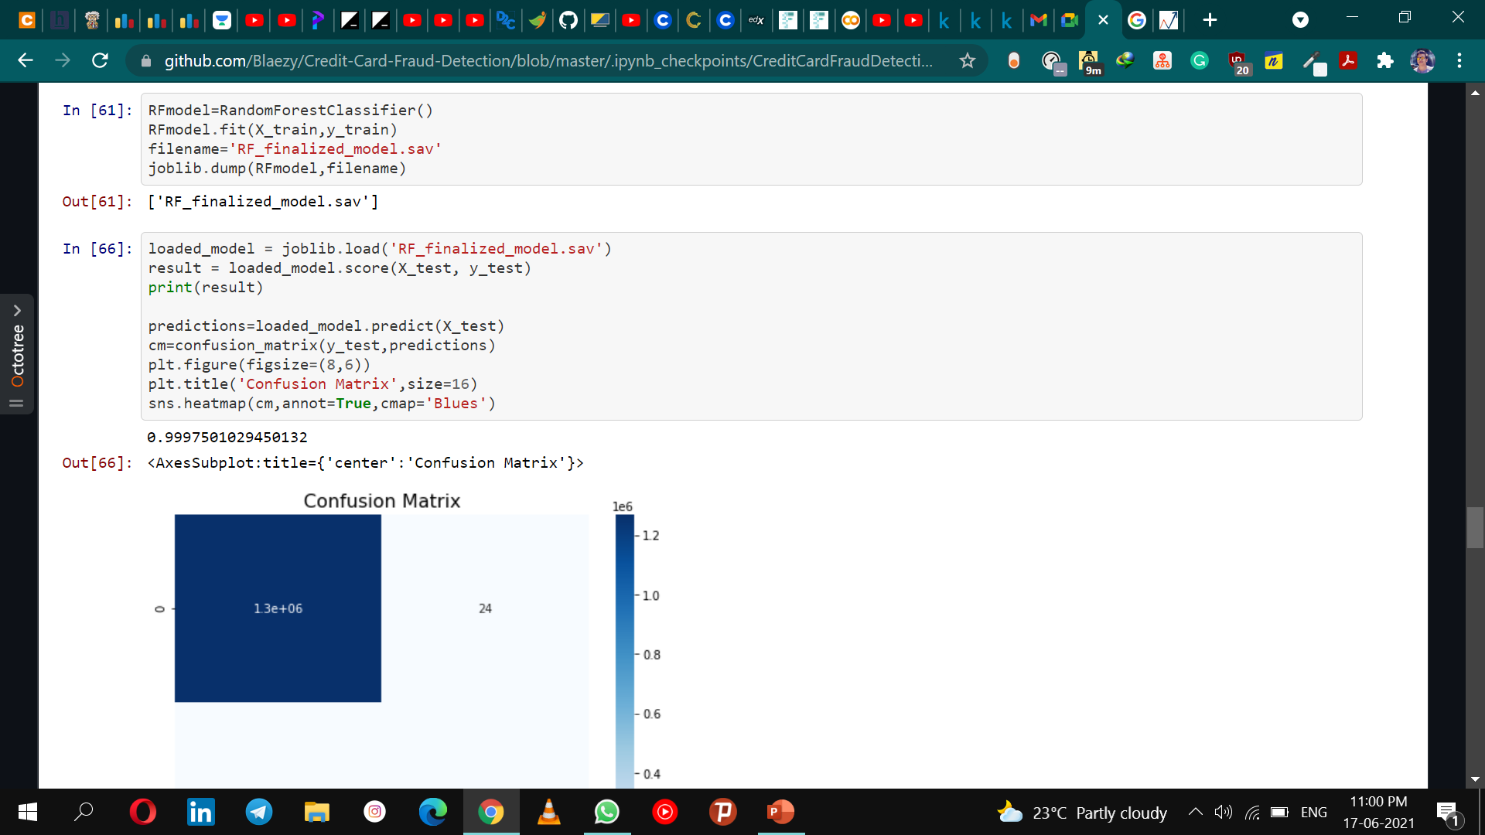
Implementation

